Slide 1
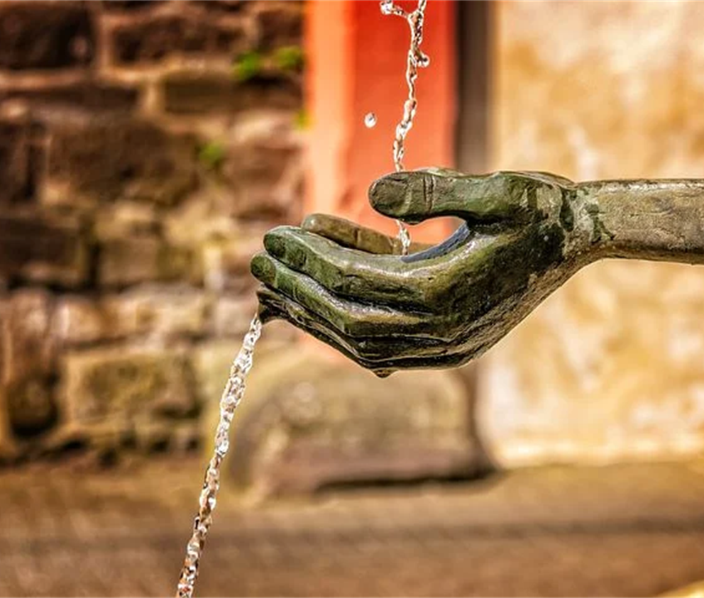
In Giving We Receive
Notes:
As educators, a ministry within the church, too often ‘giving’ maintains a strong hold on us and ‘receiving’ shrinks significantly. This session is an intended time of ‘receiving’ so that you are more able to give wholeheartedly to your ministry.
Before we pray take a moment to set aside the business of today…
Notice the giving and receiving that is part of your breathing
The rhythm of our physical breathing is similar to the rhythm of ministry.
We breath in –we receive
We breath out –we give.
Life swings between the rhythm of giving and receiving.
Kia īnoi tātou.

Slide 2
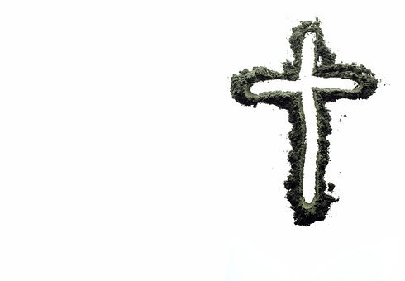
As we make the Sign of the Cross we remember the ash cross we said Amen/Yes to.
Ki te ingoa
O te Matua
O te Tamaiti
O te Wairua Tapu
Amene

Slide 3
The Law of Giving
The universe operates through dynamic exchange….
Giving and receiving are different aspects
of the flow of energy in the universe.
And in our willingness to give that which we seek,
We keep the abundance of the universe circulating in our lives.
Deepak Chopra

Slide 4
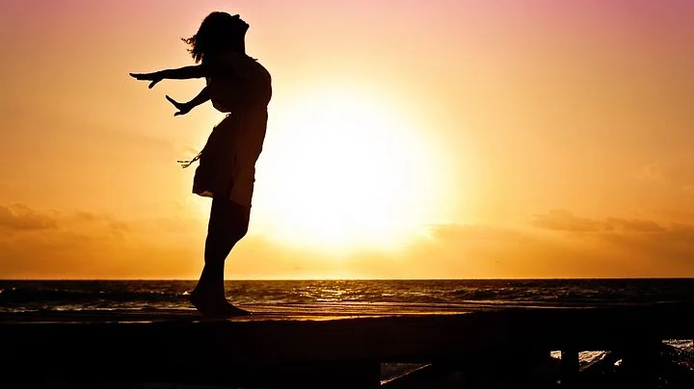
Proclamation: A Time for Giving and a Time for Receiving
There is a time to give and a time to receive:
A time to breath in and a time to breathe out.
A time to wake up and a time to go to sleep.
A time to speed up and a time to slow down.
A time to be active and a time to be still.

Slide 5
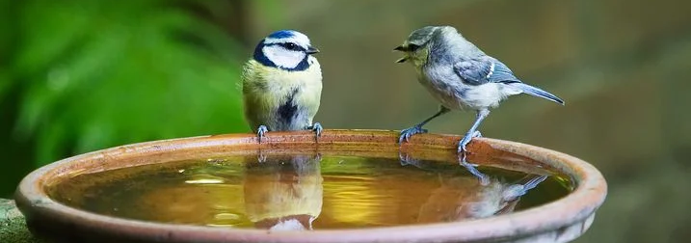
A time to speak and a time to listen.
A time to give gifts and a time to accept them.
A time to serve and a time to be served.
A time to pray alone and a time to pray together.
A time to be strong and a time to be vulnerable.

Slide 6
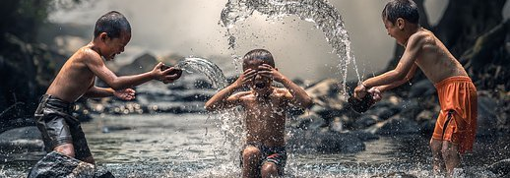
A time to hold on and a time to let go.
A time to read and a time to reflect.
A time to laugh and a time to be serious.

Slide 7
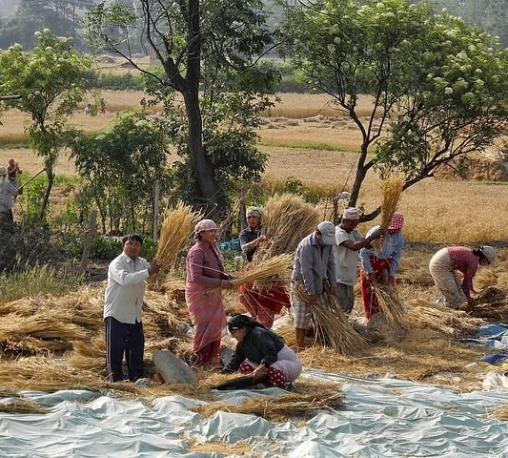
A time to reach out and a time to withhold.
A time to give away and a time to gather back.
A time to extend kindness and a time to receive it.
A time to love and to be loved.

Slide 8
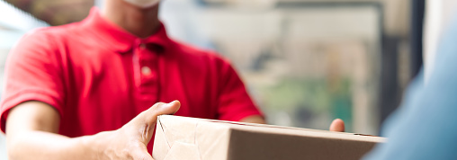
I give generously, I receive gratefully
Notes:
Take some time now to bring to mind two good deeds that you have done, two things that were good, times that you loved. They need not be grandiose: let whatever wants to arise show itself. They are usually simple .
(time to think)
Ponder a good deed someone did for you that made a difference, a time when you were loved.
(time to think)
Kia īnoi tātou (let us pray)

Slide 9
God of Reconciliation
We know that Jesus came to bring us closer to You and one another.
May the many peoples within our own country and in all nations be given courage to live in co-operation and rangimārie.
May who we are, and what we give others this Lent,
Truly help to make the world a better place.
Amen.

