Slide 1

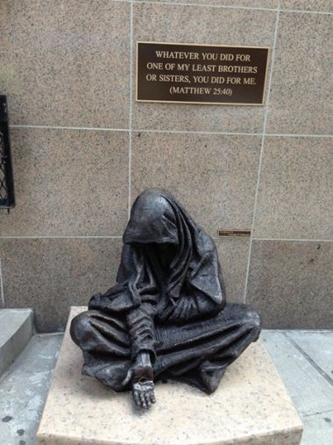

The Big
Four
Lyn Smith: lyns@cda.org.nz

Slide 2
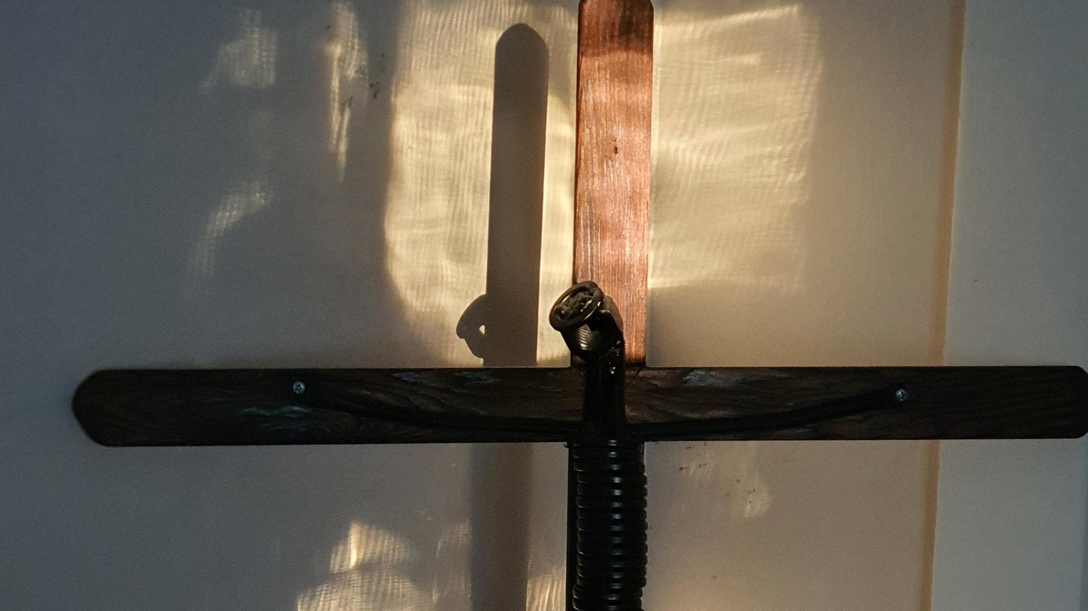
Justice (Tika) (noun)
The quality of being just or fair.
2. The principle of fair treatment or
conduct.
3. The administration of law.
4. A judge or magistrate.
(The Reed Dictionary of New Zealand English – 2001)

Slide 3
CST is based upon:
Biblical insights: Old Testament prophets & the
inspiration of Jesus preaching the Good News.
The tradition of the early writers of the Church.
Philosophy & Theological reflection &
Contemporary experience of the
People of God struggling to live
out faith in justice.

Slide 4
The central message is simple:
Our faith is profoundly social. We cannot be called truly “Catholic” unless we hear & heed the Church’s call to serve those in need & work for justice & peace.
Communities of Salt & Light US Bishops 1993.

Slide 5
This (CST) teaching rests on one basic principle,
“Individual human beings are the foundation, the cause & the end of every social institution.. On this basic principle which guarantees the sacred dignity of the individual, the Church constructs the whole of her social teaching.”
Mater et Magistra, Typis Polyglottis Vaticanis 1961, No.58. John XXIII

Slide 6
In biblical faith,
the doing of
justice is the primary
expectation of Yahweh.
Walter Brueggeman

Slide 7
Which documents are agreed in general to be CST?
1891 Leo XIII Rerum Novarum (On the Condition of Labour)
1931 Pius XI Quadragesimo Anno (Reconstructing the Social Order)t Magistra (Christianity Social
Progress)
1963 John XXIII Pacem in Terris (Peace on Earth)
1965 Vatican II Dignitatis Humanae (Decree on Religious Liberty)
1967 Paul VI Populorum Progressio (On the Development of Peoples)
1971 Paul VI Octogesima Adveniens (Call to Action)
1971 Synod Justitia in Mundo (Justice in the World)
1981 John Paul II Laborem Exercens (On Human Work)
1987 John Paul II Sollicitudo Rei Socialis (On Social Concern)
1991 John Paul II Centesimua Annus (One Hundred Years of Catholic Social Teaching)

Slide 8
Deus caritas est Pope Benedict XVI 25 Dec 2005
Spe salvi Pope Benedict XVI 30 Nov 2007
Caritas in veritate Pope Benedict XVI 29 June 2009
Lumen Fidei Pope Francis 29 June 2013
Evangelii gaudium: Apostolic Exhortation Pope Francis 24 Nov 2013
Laudato si’ Pope Francis 24 May 2015
Amoris Letitia Pope Francis 2016
Gaudete et exsultate Pope Francis March 2018
Christus vivit Pope Francis 2019
Fratelli Tutti Pope Francis 2020

Slide 9
The permanent principles of the Church’s social doctrine constitute the very heart of Catholic social teaching. These are the principles of: the dignity of the human person, which is the foundation of all other principles and content of the Church’s social doctrine; the common good; subsidiarity; and solidarity.
The Compendium of Social Doctrine of the Church 160

Slide 10
Core Principle: Human Dignity: I am made in the image & likeness of God Atua
Te Mana I Te Tangata

Slide 11
Core Principle: Common Good: Accepting what is best for humanity!
He painga ma te katoa

Slide 12
Core Principle: Solidarity: Standing with our brothers & sisters
Whakawhanaungatanga

Slide 13
Core Principle: Subsidiarity: Decisions made with & by those involved
Mana whakahaere

Slide 14
Other named CST Principles:
Justice is an essential aspect of faith
Justice requires a preferential option for the poor
Justice respects rights & responsibilities
Justice is an expression of love
Justice demands participation
Justice calls for the fair distribution of resources
Justice acknowledges the dignity of the natural world
Justice promotes peace

Slide 15
“Let us ask the Holy Spirit to pour out upon us a fervent longing to be saints for God’s greater glory, let us encourage one another in this effort”
Gaudete et exsultate Pope Francis 2018

Slide 16
Education for justice is not just an activity for the classroom or Church community. This important task requires a whole school focus. Justice needs to be shown at all levels of interaction on the local scene before we can attempt to address justice issues on a global level. Think globally act locally!
SEE – JUDGE - ACT

Slide 17
What does this mean for us as educators in the Catholic Tradition? We need to continue to discover / review / encourage:
Proclaiming the word of God (kerygma – martyria);
Celebrating the sacraments (leitourgia) &
Exercising the ministry of charity (diakonia).
We could add: Remember and emphasise our Call to Holiness
(Benedict XVI Deus Caritas Est, 2005. #25 /
NZCBC, The Catholic Education of school-aged children, 2014. #6).

Slide 18
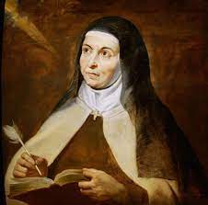

Waiho I te toipoto, kaua I te te toiroa.
Let us keep close together, not wide apart.
Photograph: LMS 2020

Slide 19
QUESTION(S):
How can the Church address the issues of injustice in society when it does not always appear to address them in its own house?
And / or
What are some of the justice issues that you are dealing with in your school context?

