Slide 1
Holiness: the call to be whole
Professor Peta Goldburg rsm FACE
peta.goldburg@acu.edu.au

Slide 2
Acknowledgement of Country

Slide 3
Video on
Mute when not speaking
Open chat

Slide 4
Holiness
Notes:
Word that can make us feel uneasy
In book of Leviticus when God was forging relationship with the community of Israel God said the Moses “Give the instructions to the whole community. You must be holy because I, the Lord your God, am holy” (Lev 19:2)
If we think about it, time, space, objects and people can all be holy
Holy spaces; objects use in worship; Sabbaths, rituals and feasts of ancient Israel, days and seasons – they were holy because they belonged to God and where in relationship with God
In the New Testament we read terms such as ‘make holy’ and Jesus is called the “holy one of God’
More often than not we think about holy – we probably think of this - rather than

Slide 5
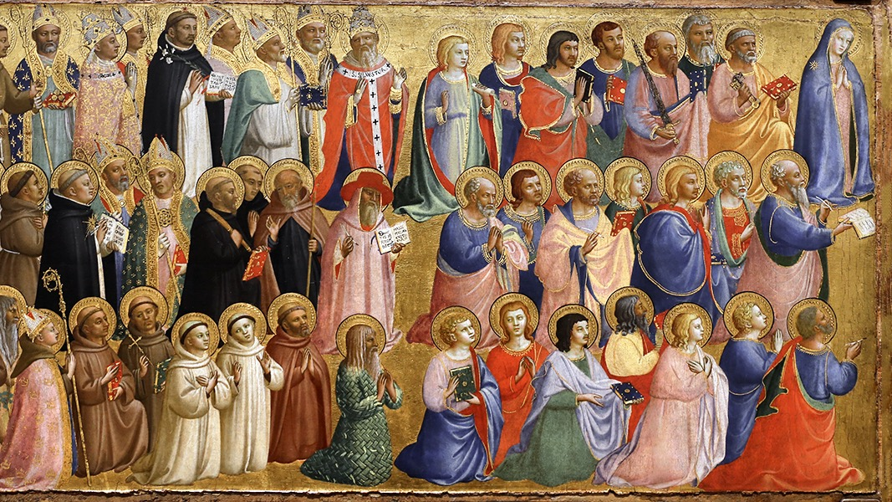

Slide 6
Notes:
Holiness is attractive
‘attractive face of the church’

Slide 7
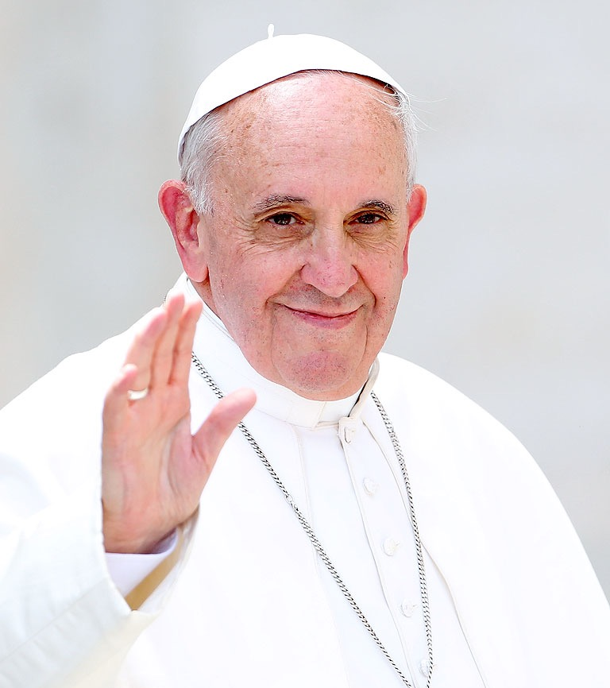
Gaudete et Exsultate
Rejoice and be Glad (2018)
Notes:
Call to be holy
Call to be saints

Slide 8
What’s an exhortation?
Letter – pastoral message
Notes:
Different ways of communicating
Encyclicals – letter to whole church - ‘carry weight’ formal documents
Exhortation - encouraging people to take certain action, behaviour

Slide 9
Constitutions
Encyclicals
Exhortations
Notes:
apostolic exhortations rank third after apostolic constitutions and encyclicals. Generally, apostolic exhortations present a pastoral message which encourage particular virtues or activities. Apostolic exhortations do not define Church doctrine and are not considered legislative.

Slide 10
Notes:
Sub title – the call to holiness in today’s world
Released on 9 April 2018 - Feast of the Annunciation
When the angel visits Mary and invites her to be Mother of Jesus
Mary, the wise young pre-pubersent girl that she was, does not respond immediately but rather questions the angel - How can this be? - she asks a question before considering her response.
As we know – she said yes – and since that time she has been described as a model disciple
Not a model of passivity but model who thinks, and questions
A disciple as Amy Jill Levine says one who learns, questions does not follow aimlesszxles

Slide 11
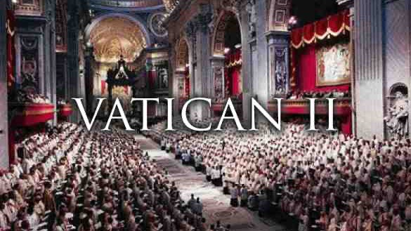

Slide 12
Vatican II
Resourcement
Aggiornamento
Returning to the sources
Bringing up to date

Slide 13
Key themes Francis’ papacy
Synodality – journeying together
Dialogue
Holiness and Saints

Slide 14
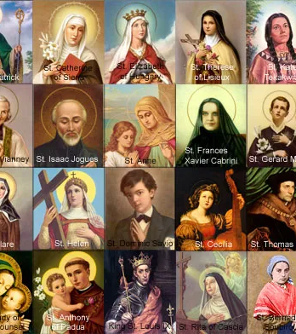
either or
both and

Slide 15
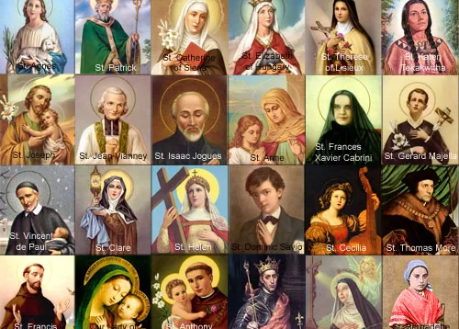
Communion of Saints

Slide 16
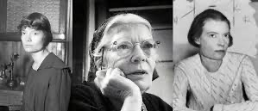
Dorothy Day
“Don’t call me a saint. I don’t want to be dismissed that easily”
Notes:
We admire saints from afar; know their sotires; have statues BUT we don’t think thie lives and the choices that shpend theisle have anything to do with us personally
Saints are just like and me!
They weren’t born saints – they have desire to be holy – to do will of God
They had choice and so do we!

Slide 17
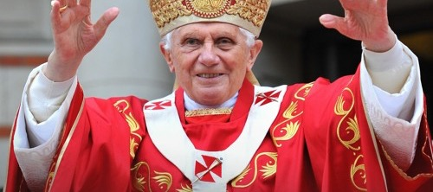
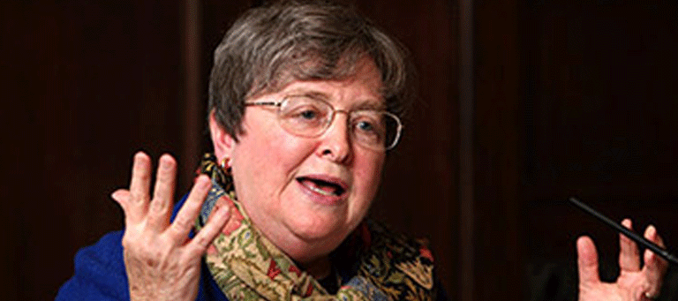
‘Friends of God’
Elizabeth Johnson
Pope Benedict XVI
Notes:
Friends of God - not quaint stories about unusual people who did extraordinary things
What all saints have in common is Their ability to respond to God’s call in unique circumstances and social locations
The communion of saints is all people of truth and love - all people of ‘good will’
Example of Maximillian Kolbe or
Holiness is not for select few and we don’t have to withdraw from ordinary life and spend time in solitude or in prayer
Response to God’s spirit

Slide 18
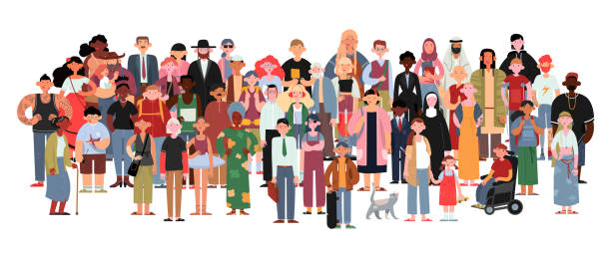
Notes:
In broadest sense holiness and ;friends of God’ not limited to ‘us’
Re propose the call to holiness in a “{practical way for our own time, with all its risks challenges and opportunities”
If we remember first genesis creation account where wind from God moved over the waters

Slide 19
Ruah

Slide 20
Breath of God
Genesis 1:2
“…a wind from God swept over the face of the waters…”
Genesis 2:7
“…and God breathed into the nostrils the breath of life…”
Acts 2:2
“…and suddenly from heaven there came a rush of wind…”

Slide 21
Spirit of God

Slide 22
Spirit
Notes:
Spirit of God present in all human life
What Pope Francis reminds us, drawing on the teachings of the second Vatican council is that we live in relationship with other and in relationship with the world arounds us

Slide 23
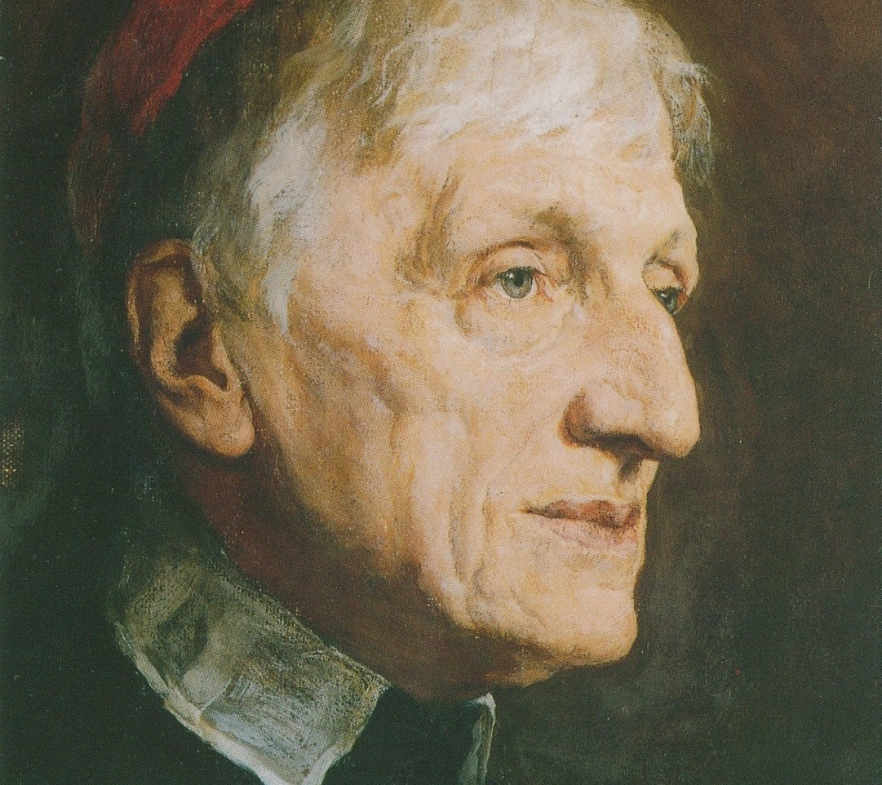
Cardinal Newman
conspiratio
‘breathing together’

Slide 24
We are all called to by holy by:
living our lives with love
bearing witness in everything we do
wherever we find ourselves (GE 14)
Notes:
Holiness is about the whole of life - not compartmentalized part of life but the whole of life

Slide 25
Holiness is not…
1 or 2 big gestures
removing ourselves from society
Notes:
Francis begins by explain what holiness is not

Slide 26
Holiness is…
small gestures
little decisions
how we shape our attitudes
what we do for others

Slide 27
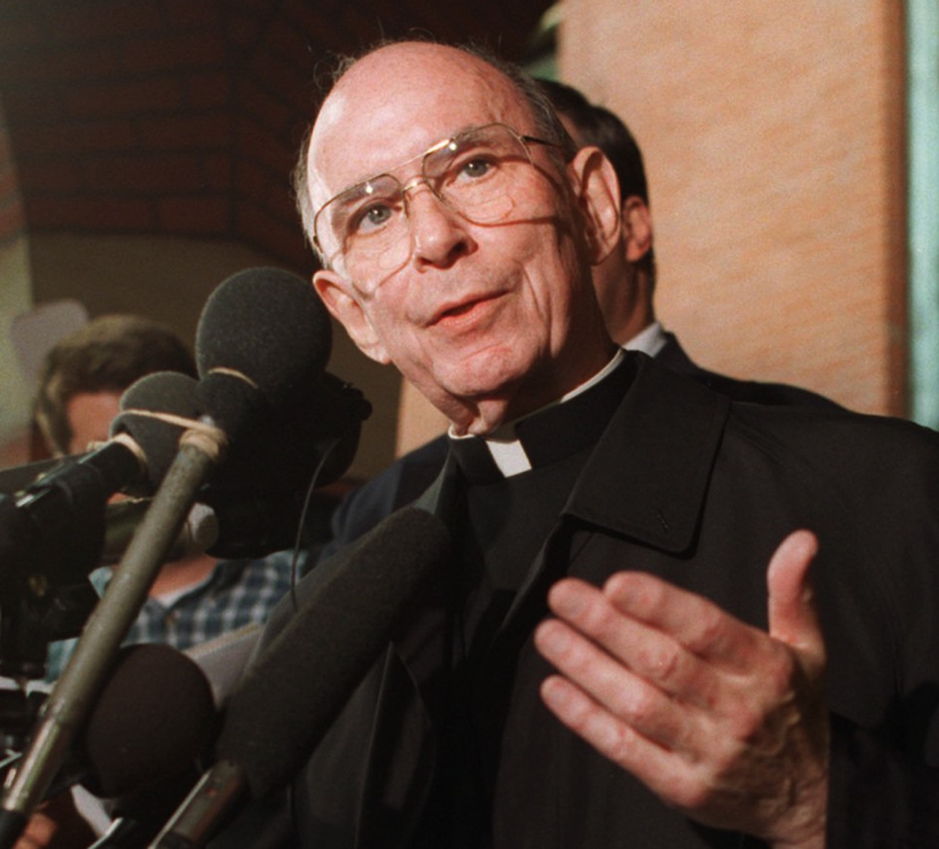
Cardinal Bernardin - Chicago
“consistent ethic of life”
“seamless garment”

Slide 28
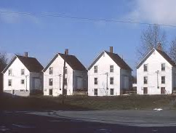
Holiness does not look the same for everyone
We need to discern our own path
Bring out the best in ourselves

Slide 29
Path to holiness
Never independent or an individual process
Enter into a community
Live our call to holiness with each other
‘Ubuntu’
Notes:
Our call to holiness is at baptism
Ubuntu - Fratelli tutti
It is uniquely described by the (Southern) African word ‘Ubuntu’ meaning ‘I am who I am because of who we are together’; and it has also been translated as ‘humanity towards others’ and ‘a person is a person through other persons’. In Fratelli Tutti, Francis says, “Each of us is fully a person when we are part of a people; at the same time, there are no peoples without respect for the individuality of each person” (FT #182). Further insights into Ubuntu may be gained by reading Dreyer, J.S (2015). Ubuntu: A practical theological perspective. International Journal of Practical Theology. Vol.19 (1), 189-209.
We can only be Christian in community
Awareness of communal dimension of Christian life

Slide 30
Holiness and Community
Call to holiness is lived out in
Relationship
Community
Dialogue
How do we respond to the call to holiness as a community?
Notes:
Not a question of What am I getting out of this ? But rather, How am I bringing about reign of God (*presence of God in the World)

Slide 31
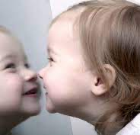
How do I reflect God in the World?
Genesis 1: “…people made in image and likeness of God”
I am a reflection of God in the world
How do I make a difference?
Notes:
Co –creators with God in the world
“there are Christian whose live seme like Lent without Easter” ( EG 6)
Joy, humor, lightheartedness and pace are hallmarks of the Christian life
To be holy does not men surrendering the ability to laugh or enjoy good company

Slide 32
Notes:
Do I compartmentalize my life

Slide 33
Notes:
A life that stives toward holiness, incorporates everything

Slide 34
Developing holiness
Developing prayer life
“moments of quiet, solitude and silence before God (GE 29)
“every minute of our lives can be a step along the path to growth in holiness” (GE 31)
Notes:
Holiness just doesn’t happen - it’s like most things we need be conscious and pay attention
Exercise,
St Francis of Assisi moved from ‘saying prayers’ to ‘living prayer’
Holiness – shift in out things that encourages us to integrate prayer – constant communication to God by our actions, words and through- into the whole of the fabric of our lives
Call on Holy spirit
Intercession of those before us ‘communion of saints’
Personal and communal prayer

Slide 35
Two enemies of holiness
Gnosticism
Peleganism
Notes:
Threats against holiness
Both heresies in early church
Gnostisism - knowledge and secret knowledge
Peleganism –
Gnosticism - heresy stressed ‘knowledge’ (secret knowledge) denied goodness of creation
Pelagianism – heresy of 5th century which said the salvation possible through human effort alone, without grace

Slide 36
Contemporary Gnosticism
Tendency to elevate the ‘intellectual or spiritual’
Denigrate the material, physical
“a person’s perfection is measured not by the information or knowledge they possess but by the depth of their caritas” (love for others/charity/action) GE 37
“not what we know and write but rather what we do and love”

Slide 37
Contemporary Pelagianism
“false form of holiness” (GE 35)
Rely on grace of God
Recognition that our holiness is not exclusively our doing or the result of own will
God invites us and we choose to respond

Slide 38
Holiness is practical and concrete
Don’t domesticate the Gospel!
It’s meant to be unsettling
It’s meant to challenge

Slide 39
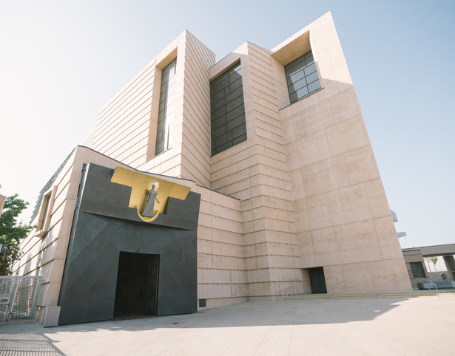
Cathedral of Our Lady of the Angels
Los Angeles

Slide 40
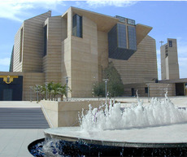
Our Lady of the Angels
Began 1999 completed 2002
Spanish architect Prof Jose Rafael Moneo
Contemporary design – no right angles – feeling of mystery and majesty
Population of Los Angeles – Chinese, Japanese, Korean, Mexican, Armenian, African American, Filipino, Polish…
Challenge: reflect diversity of all people
Internal art works (John Nava)
Three tapestries: Baptistry, Altar, Communion of Saints

Slide 41
See, Think, Me, We…

Slide 42
SEE – look closely at the images. What do you notice? Make lots of observations
THINK – What thoughts do you have about the images?
ME – What connections can you make between you and the images?
WE - How might the images be connected to bigger stories?

Slide 43
See
Look closely at the images
What do you notice?
Make lots of observations
Don’t interpret yet, just look and describe

Slide 44
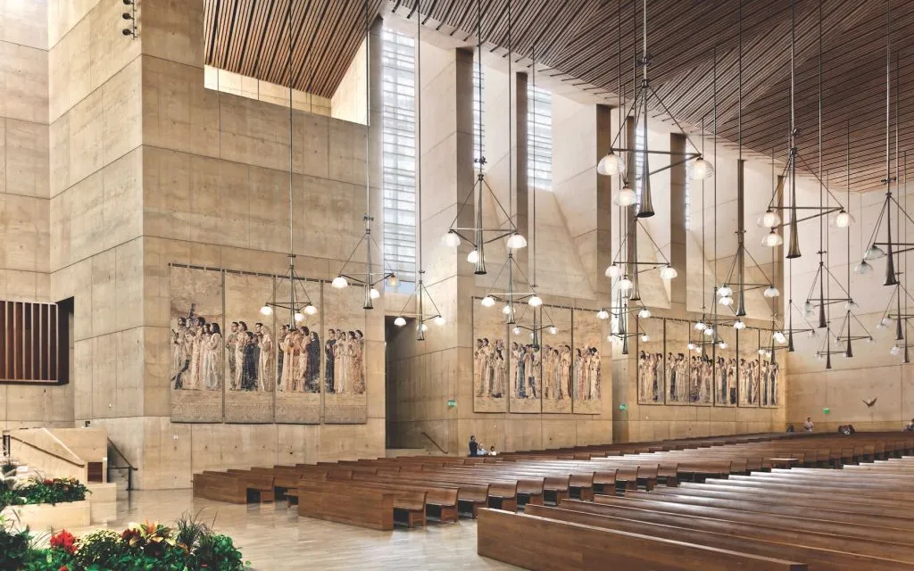

Slide 45
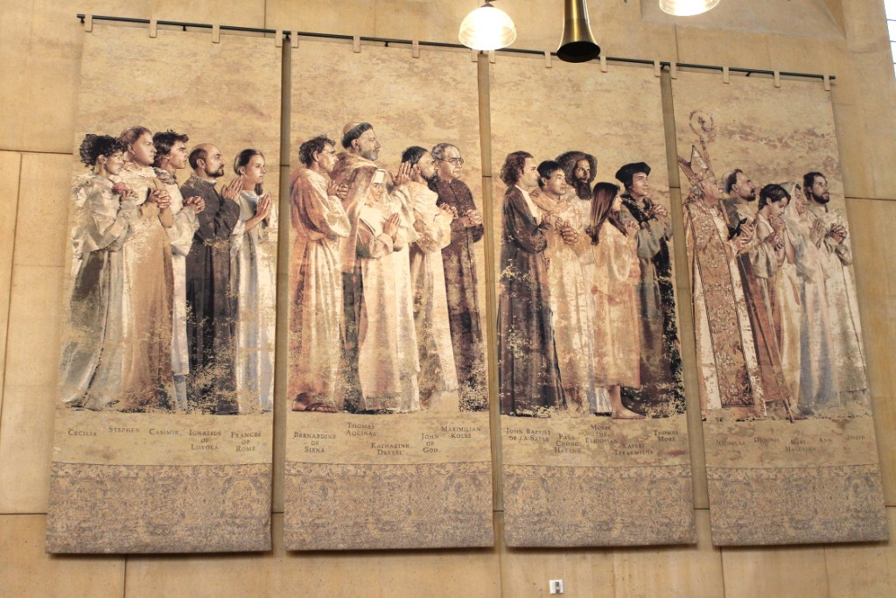

Slide 46
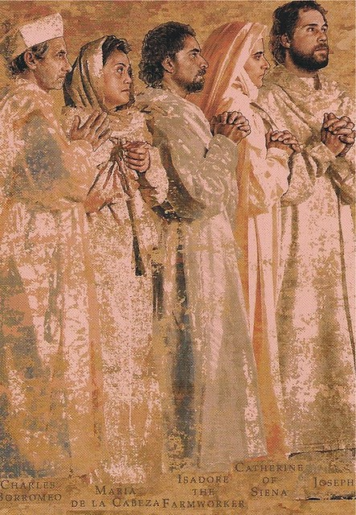

Slide 47
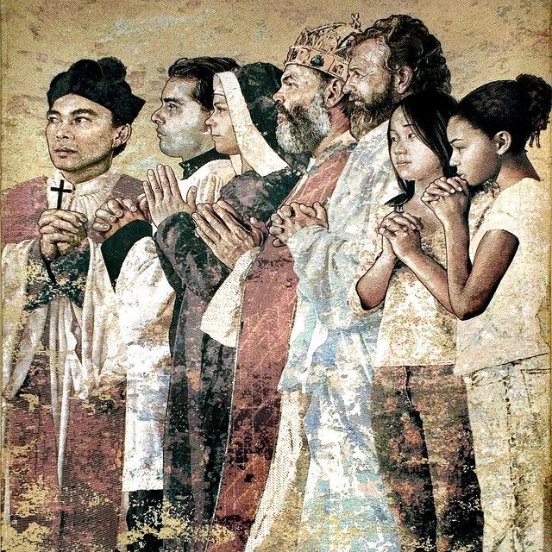

Slide 48
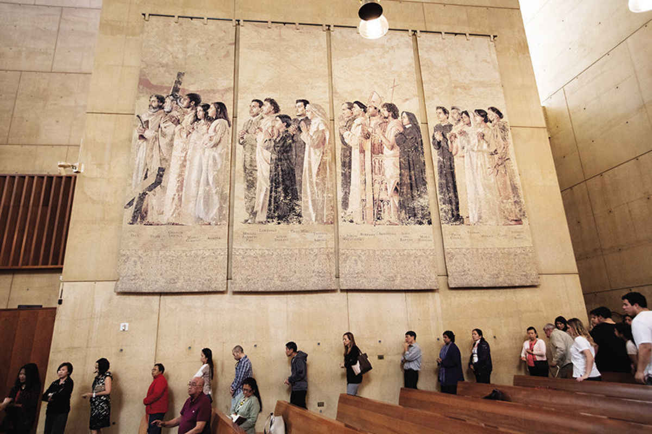

Slide 50
THINK
What thoughts do you have about the images?
Prompts
What’s going on in the images?
What might it mean?
What makes you think/say that?

Slide 57
ME
What connections can you make between you and the images?

Slide 64
WE
How might the images be connected to bigger stories?

Slide 65
WE
Make connections beyond ourselves
How do the personal connections you identified in ME connect to larger themes of human experience - WE

Slide 67
Holiness
Makes us more human
Frees us from selfishness and complacency

Slide 68
Will you respond to the call?

Slide 69
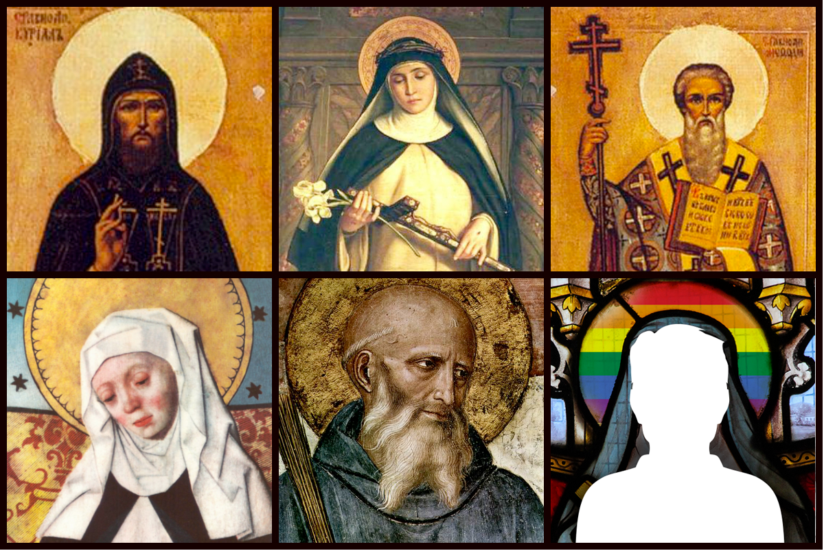
Holiness?

Slide 71
Break Out Session

Slide 72
Our lady of the Angels Cathedral
See, Think, Me, We…

Slide 73
Take time
Connect
How does holiness connect to something I know?
Extend
What new ideas do I have that extends my understanding in a new direction?
Challenge
What is challenging or confusing? What do I
wonder about?

Slide 74
Circle of viewpoints
1. New RE teacher – no experience
2. Principal or School Leader
3. Person who is not a member of the Catholic Christian tradition
4. Student in primary school
5. Student in senior secondary school

Slide 75
5 ‘viewpoints’
Task: According to your allocated/selected viewpoint, explore the Holiness using the following sentence starters:
I am thinking of the Holiness from the viewpoint of…
I think… [describe Holiness from this viewpoint. Be an actor – take on the character of your viewpoint]
A question I have from this viewpoint is …

Slide 76
Questions or Comments

