Slide 1
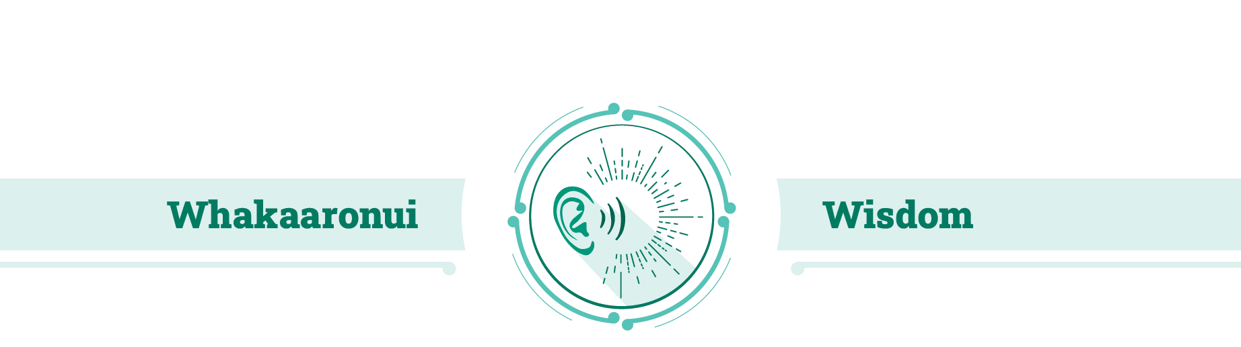


symposium with Fr Merv Duffy SM, Lecturer in Theology at Te Kupenga – Catholic Theological College
To Tātou Whakapono Our Faith

Slide 2
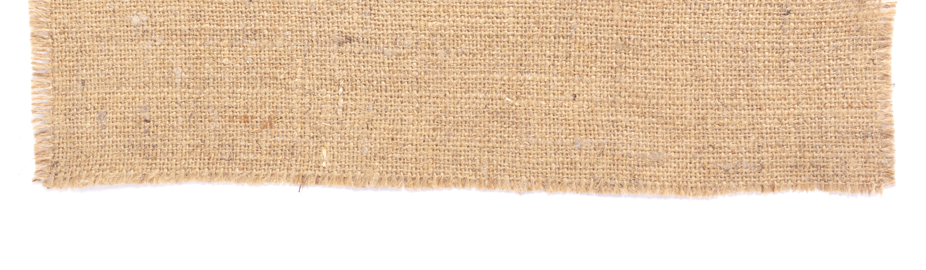
Great is the wisdom of the Lord!
God Almighty, Your Wisdom includes
An understanding of what is fair,
What is logical, what is true,
What is right and what is lasting.
It mirrors Your pure intellect!
I entreat You to grant me such Wisdom,
That my labours may reflect Your insight.
Your Wisdom expands in Your creations,
Displaying complexity and multiplicity.
Your Wisdom is an eternity
ahead of humanity.
May Your wisdom flourish forever!
Amen
Prayer for Wisdom

Slide 3

What is it?
Whakaaronui Wisdom is
seeing with the eyes of God.
In Scripture and the Tradition of the Church it is often referred to as a gift from God. It is also reflected, particularly in the Religious Education context, as the knowledge, understanding, Tradition and teaching of two thousand years of being Church.

Slide 4
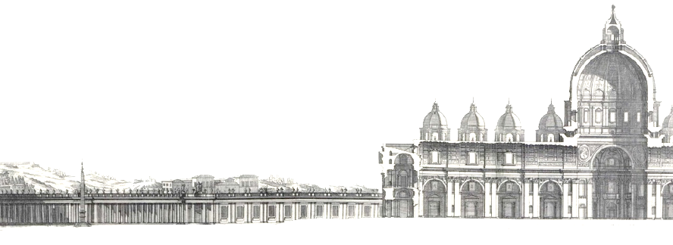
Vatican II – Dei Verbum 10
Sacred tradition and sacred Scripture form one sacred deposit of the Word of God, committed to the Church. Holding fast to this deposit the entire holy people united with their shepherds remain always steadfast in the teaching of the Apostles, in the common life, in the breaking of the bread and in prayers, so that holding to, practicing and professing the heritage of the faith, it becomes on the part of the bishops and faithful a single common effort.

Slide 5
Vatican II – Dei Verbum 8
Sacred Tradition = ?
Now what was handed on by the Apostles includes everything which contributes toward the holiness of life and increase in faith of the People of God; and hands on to all generations all that she herself is, all that she believes.

Slide 6
Implications
We do not teach “Scripture alone”
We do teach from “Scripture and Tradition”
We are a Church with a long history that we treasure (and it includes stuff that we now regret)
We are a worldwide Church with experience in many different countries and cultures
We are “standing on the shoulders of giants” (and saints)
We listen to the voices of our ancestors in the faith
We listen to the teaching authorities within the Church
Notes:
We have learnt from our mistakes (though we manage to repeat many of them)

Slide 7
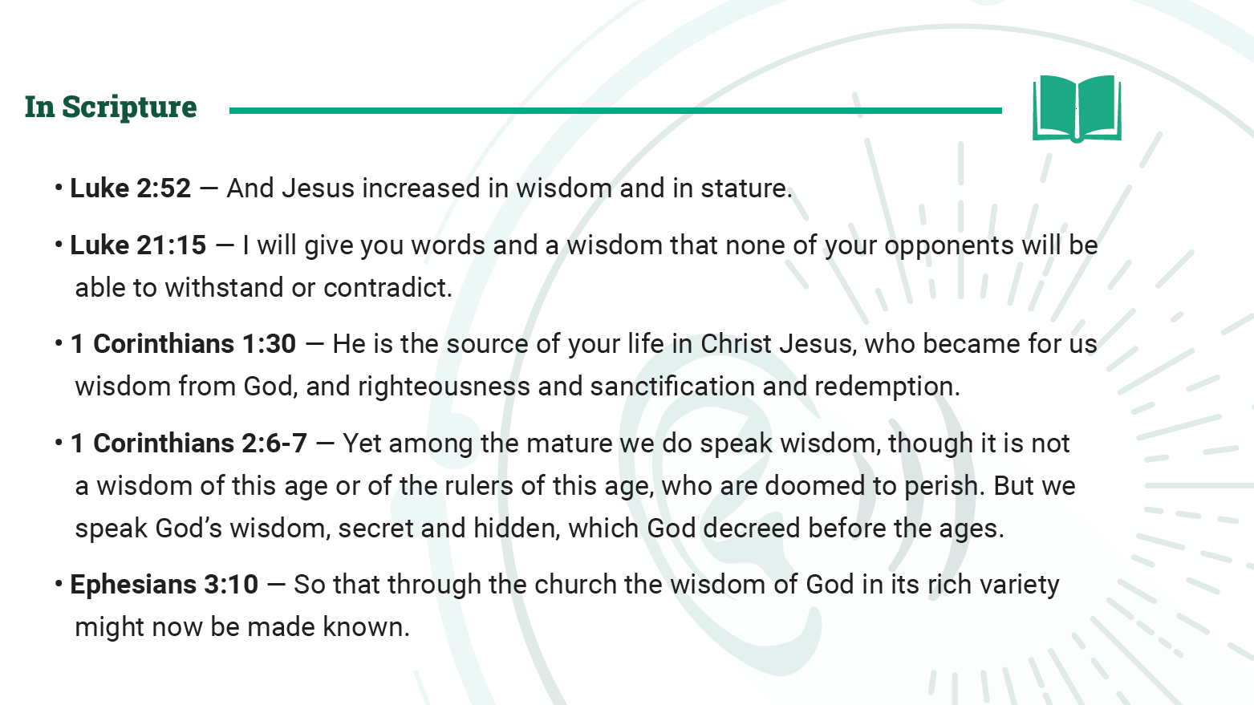
Notes:
The curriculum document gives us a set of scriptural texts that show different aspects of Wisdom. That show us how the word is used in the bible.
Jesus increasing in wisdom and stature means that he grew and learnt as human beings do. – He too learnt wisdom.
So, wisdom is a normal human attribute, like stature – wisdom is life experience.
Luke 21 identifies the importance of words and wisdom in argument and debate. We need wisdom to express and defend our ideas.
The person of Jesus is identified in 1Corinthians as holy Wisdom in person. Hagia Sophia in Constantinople was the Church to Holy Wisdom – meaning by that title Christ himself.
The second passage from 1 Corinthians distinguishes the wisdom of this age from God’s wisdom which we speak. Our Catholic worldview is different from other viewpoints of our time.
St Paul in Ephesians charges the church with the responsibility of making the wisdom of God known.

Slide 8
Key Assumption
Revelation is communication

Slide 9
Three Ideas that are different but connected
Revelation
Revelation is from God
  The inspiration of the prophets
  What happened on Mt Sinai
  The 10 Commandments
  The Person, teachings
  and actions of Jesus
  Revelation is the work of God
Theology
Faith

Slide 10
Three Ideas that are different but connected
Revelation
Revelation is received in faith
  God’s truths are revealed
  to SOMEONE with faith
  Revelation is communication
    It needs a hearer as well as a speaker
  If no one believes nothing
  is revealed
  Faith is usually supported by a community
  Faith, too, is a gift from God
Theology
Faith

Slide 11
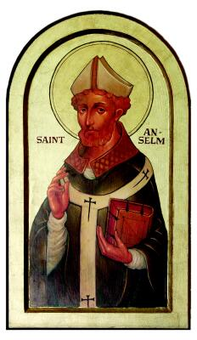
Three Ideas that are different but connected
Revelation
Human beings always think about things
  Faith does not simply hear
  it also tries to understand
  Theology is faith seeking understanding
  It is a human work
  There are many different theologies
Theology
Faith
Saint Anselm (1033-1109)

Slide 12
Different Theologies
The ONE experience of
the ministry, death,
resurrection and ascension
of Jesus

Slide 13

Isn’t the Bible enough?
Why do we need wisdom?
The Bible is complete and unchanging
Time passes and the world changes
Early Church
Patristic
Medieval
Renaissance
Reformation
Enlightenment
Modern
The faith witnessed to in the scriptures needs to thought over and over again in each era
Every culture and every period of history has its own questions

Slide 14


Theology looks two ways
To the Past
To the Present
To the Christ-event
and to the scriptures which are part of that event.
To the Church’s experiences.
To the questions and needs of today’s world

Slide 15
Theology needs Faith
Thinker
Theologian

Slide 16
But faith alone is not enough
Critical thought
Logic
Study
Knowledge of the Bible
Knowledge of the teaching of the Church
Knowledge of the world

Slide 17
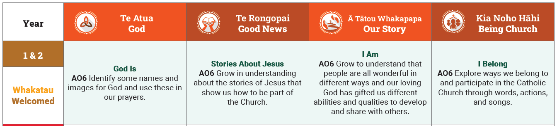
So how do we teach Wisdom?
What is the content that we need in our curriculum?
What is the appropriate pedagogical order for teaching that content?
Notes:
Year 1 2 students are being welcomed into the School and into religious education.

Slide 18
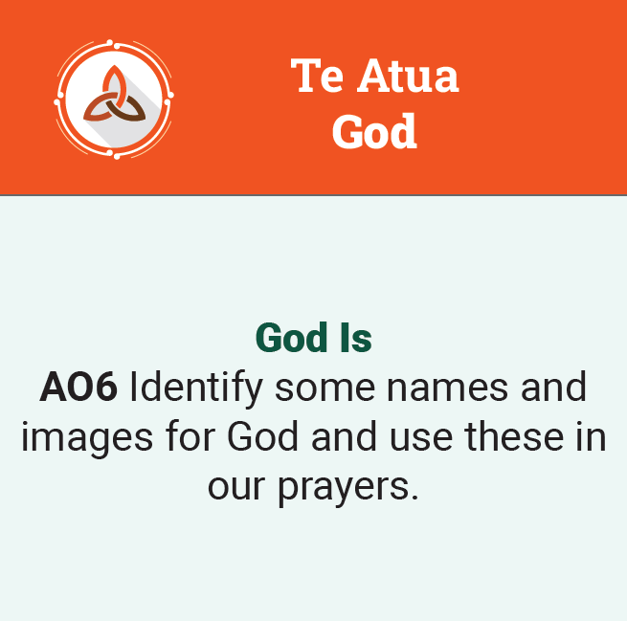
So how do we teach Wisdom?
What is the content that we need in our curriculum?
What is the appropriate pedagogical order for teaching that content?
Notes:
The starting point is “God Is” – we show them in simple ways that our schools are God-centred environments, that they are places where the existence of God is affirmed, prayer is normal, God is named.

Slide 19

So how do we teach Wisdom?
What is the content that we need in our curriculum?
What is the appropriate pedagogical order for teaching that content?
Notes:
We tell stories about Jesus – this is very literally proclaiming the good news of Jesus Christ

Slide 20

So how do we teach Wisdom?
What is the content that we need in our curriculum?
What is the appropriate pedagogical order for teaching that content?
Notes:
We try and connect it to their reality. The starting point of that is an affirmation of the good of their existence. Our schools welcome students as good, valuable and lovable.

Slide 21
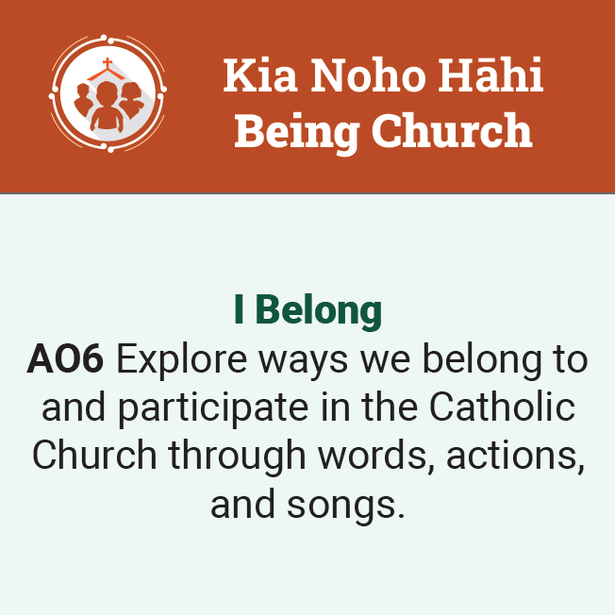
So how do we teach Wisdom?
What is the content that we need in our curriculum?
What is the appropriate pedagogical order for teaching that content?
Notes:
Welcoming into a Catholic school involves welcoming them into an experience of the Catholic Church. The school community may be the first expression of church they have encountered. We want them to feel they belong and the way to do that is to teach them the words, songs and actions of Catholic practice.

Slide 22
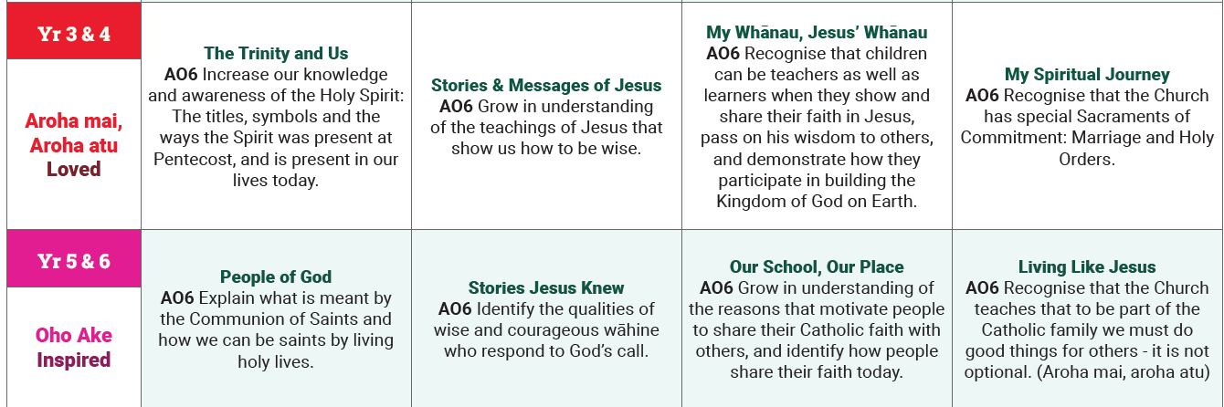
So how do we teach Wisdom?
Notes:
The follow up theme to ‘Welcome” is ‘Loved” and appropriately right from this young age they are introduced to God as Trinity, and especially to the person of the Holy Spirit.
There are two types of significant religious figures in the Old Testament – the prophets and the sages – the former challenged the people to keep the covenant, the latter advised the people on how to live wisely and well.
The characteristic format of sage teaching was the Proverb – the whakatauki.
Jesus is a prophetic figure, and was identified in his own time as a prophet, but he is also a sage, a wisdom figure and the people of his time wondered where he got his wisdom.
Jesus invites us into the whanau of God – he invites us to accept him as our brother, and to call God “Father” as he does.
The Kingdom of God was central to the preaching and message of Jesus and it is introduced here, not as heaven in the hereafter but as the Kingdom here and not yet on this earth.
The Sacraments of Vocation are introduced – two states of life, the married and the ordained.
Then, years 5 & 6 are themed as “inspired” where we see the Holy Spirit at work. Saints and the call to holiness are introduced, as are heroic women of the Bible.
The building of the Kingdom of God is to start in the place where they are, their school.
The foundation of ethics is introduced, the teaching of the beatitudes and the attitudes of Jesus. If we are loved we are to show love. The greatest and the second commandments: Love the lord your God and your neighbour as yourself

Slide 23
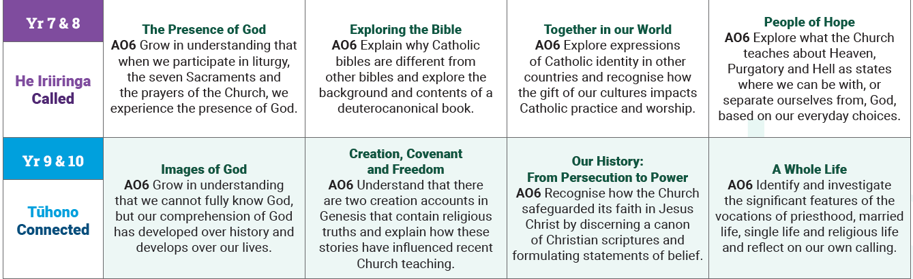
So how do we teach Wisdom?
Notes:
“Called” is the theme for Years 7 & 8 – the presence of God in liturgy, sacraments and worship.

Slide 24

So how do we teach Wisdom?
Notes:
The Bible starts to be looked at more critically – an easy starting topic is the difference between Catholic and Protestant bibles. Catholics have a chunk of the Old Testament that most Protestants don’t include: Tobit Judith Baruch Sirach 1 Maccabees 2 Maccabees Wisdom (plus additions to Esther, & Daniel) – most of these are Wisdom literature – which fits the theme rather well and is a nice objectively observable fact that can raise all sorts of good questions. Why do we have them? Why don’t they? What is the difference between Catholic and Protestant.

Slide 25
So how do we teach Wisdom?
Notes:
While introducing differences between churches the curriculum also tries to convey something of what it means to belong to a world-wide church – an introduction to the bigness of Catholicism.
As well as the Church today they study what the Church is destined for – the End Times, Heaven and Hell which raises the question of what is evil and why does God permit it.

Slide 26
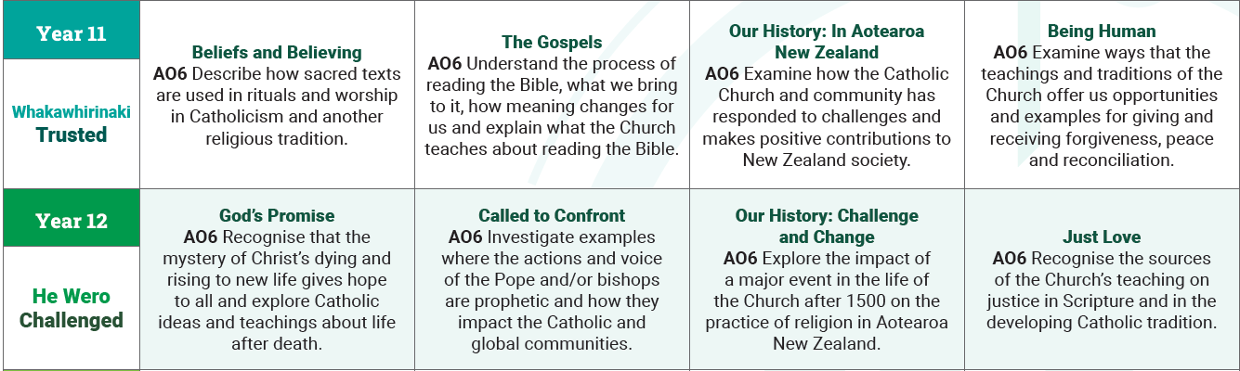
So how do we teach Wisdom?
Notes:
At Year 11 we start to run into achievement standards – which has proven tricky because they ARE being revised.
Note the level 1 “Describe” skill being used about sacred texts. We want them to understand how Catholics use the Bible in Liturgy and they can study how the Koran is used in Islam (for example) as a contrast.
The theme is “trusted” and one feature of post-Vatican II Catholicism is that Catholics are trusted to read and interpret the scriptures. We do want to give them some pointers on how to do this, how to avoid literalism, how to read the Bible as the Church’s book.

Slide 27
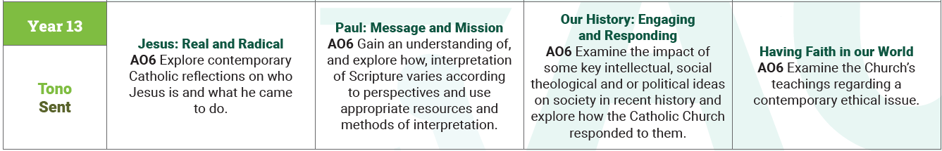
So how do we teach Wisdom?

Slide 28
Questions
What was the most important “Wisdom” insight that you personally gained during your years of schooling?
  Do you see where it would fit in this curriculum? What year?
  How would you teach it to students?
Share your insight and your method with your group

Slide 29
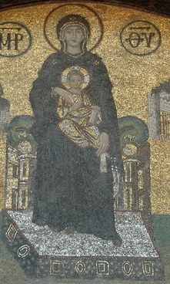
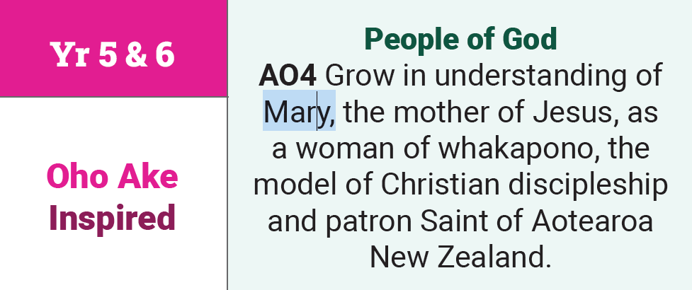
My Wisdom Insight
Mary as “Throne of Wisdom”
Mosaic from Hagia Sophia

Slide 30
Questions
What was the most important “Wisdom” insight that you personally gained during your years of schooling?
  Do you see where it would fit in this curriculum? What year?
  How would you teach it to students?
Share your insight and your method with your group

