Slide 1


Slide 2

E te Atua tō mātou kaihanga
ka tīaho te māramatanga me te ora,
i au kupu kōrero,
ka tīmata āu mahi,
ka mau te tika me te aroha;
meatia kia ū tonu ki a mātou
tōu aroha i roto
i tēnei mahi – mahitahi,
Whakakī a mātou whakaaro
ā mātou mahi katoa
e tōu Wairua Tapu,
Āmene
God our Creator,
when you speak there is light and life,
when you act there is justice and love;
grant that your love may be present in what we do together,
so that what we say and what we do
may be filled with your Holy Spirit

Slide 3
To consider
Where is justice already happening now in your school/college?
What makes justice at your school/college any different to the school down the road
Do you have any practical suggestions to help young people recognise the connection between their desire for justice and the Catholic faith?

Slide 4
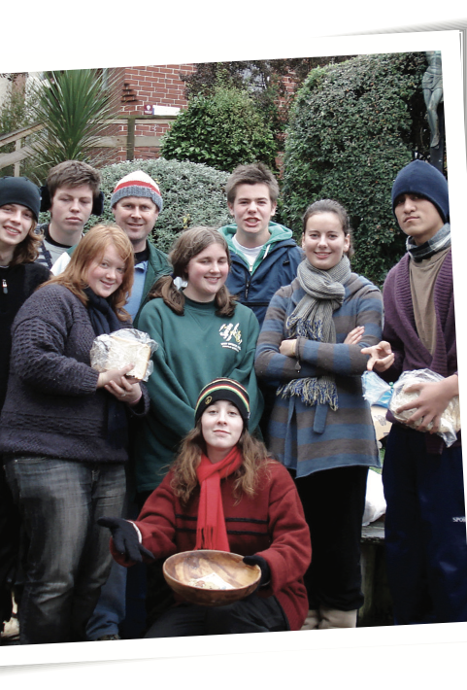
Aim:
Young people will develop an understanding of how God’s justice can protect and transform our world. They will learn how Tika Justice can help us engage in right relations with God, ourselves, others and all creation. They will develop an understanding of the importance of restorative justice, how it differs from retributive justice, and the consequences of choices and actions.

Slide 5

“An authentic faith –which is never comfortable or completely personal – always has a deep desire to change the world, to transmit values, to leave this earth somehow better than we found it.” – Pope Francis Evangelii Gaudium

Slide 6
Aim:
Young people will develop an understanding of how God’s justice can protect and transform our world. They will learn how Tika Justice can help us engage in right relations with God, ourselves, others and all creation. They will develop an understanding of the importance of restorative justice, how it differs from retributive justice, and the consequences of choices and actions.

Slide 7
“[Jesus] seems to see his task as that of encouraging his listeners to take simple but quite radical steps of trust, reciprocal forgiveness, and solidarity in the acknowledgement of human dignity.” – Monica Hellwig

Slide 8
Aim:
Young people will develop an understanding of how God’s justice can protect and transform our world. They will learn how Tika Justice can help us engage in right relations with God, ourselves, others and all creation.
They will develop an understanding of the importance of restorative justice, how it differs from retributive justice, and the consequences of choices and actions.

Slide 9
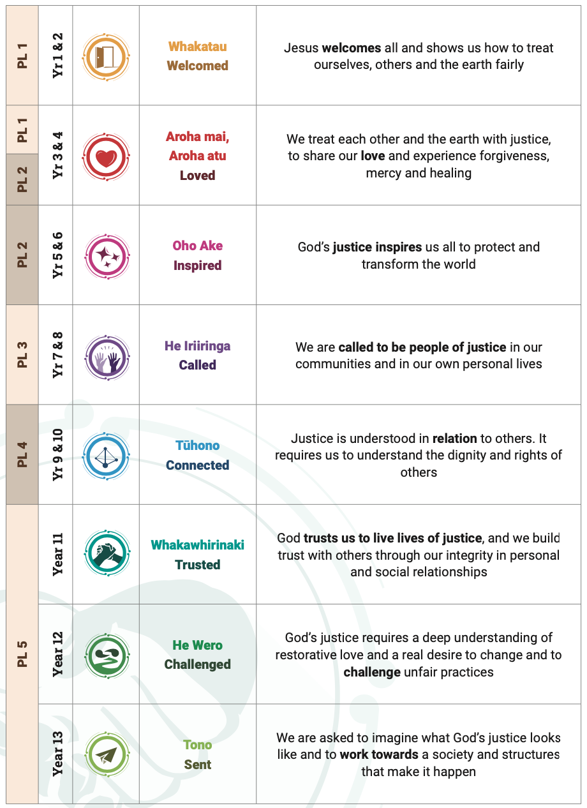

Slide 12
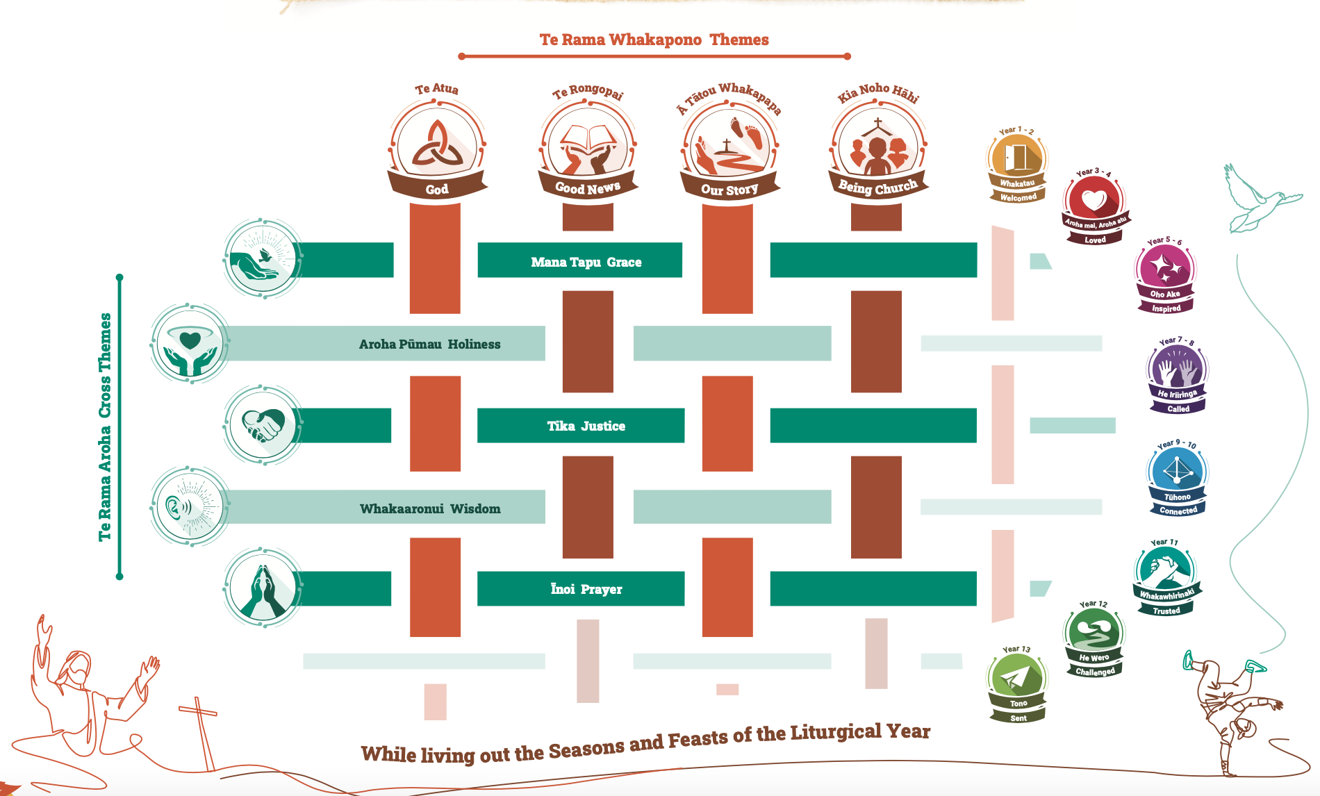

Slide 16
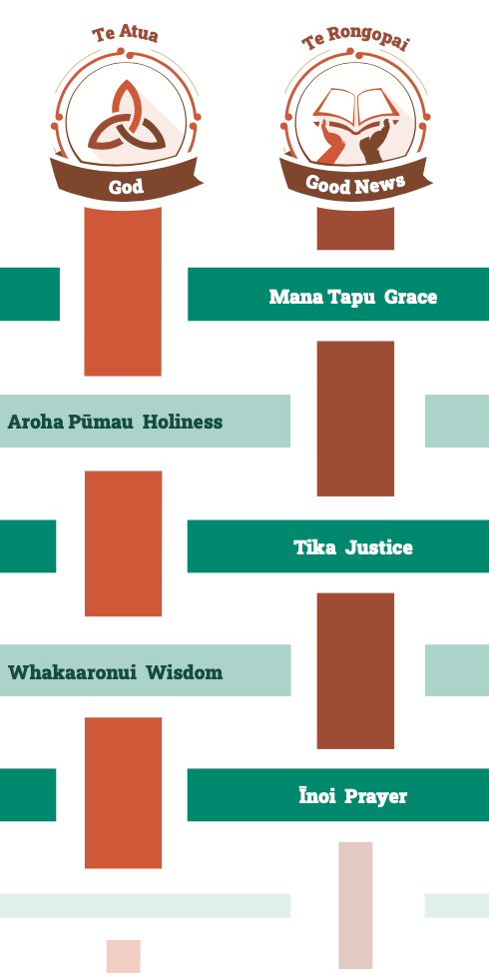




Slide 17
SOURCES
Scripture
Lived Tradition
Reason (Natural Law)
Experience

Slide 18
CATHOLIC SOCIAL TEACHINGS
Rerum Novarum (1891) – Leo XIII
Quadragesimo Anno (1931) – Pius XI
Mater et Magistra (1961) – John XXIII
Pacem in Terris (1963) – John XXIII
Gaudium et Spes (1965) – Vatican II
Populorum Progressio (1967) – Paul VI
Octogesima Adveniens (1971) – Paul VI
Evangelii Nuntiandi (1975) – Paul VI
Laborem Exercens (1981) – JP II
Sollicitudu rei Socialis (1987) – JP II
Centisimus Annus (1991) – JPII
Caritas in Veritate (2009) – Benedict XVI
Laudato si’ (2015) - Francis

Slide 19
PRINCIPLES
Human Dignity
Common Good
Solidarity
Subsidiarity
Participation
Stewardship
Preferential Option for the Poor
Notes:
We can add other principles – distributive justice, promoting peace,
but for us these develop in the CSTs mentioned previously
They arise in a context
They are all an expression of human dignity
They are interconnected.

Slide 20
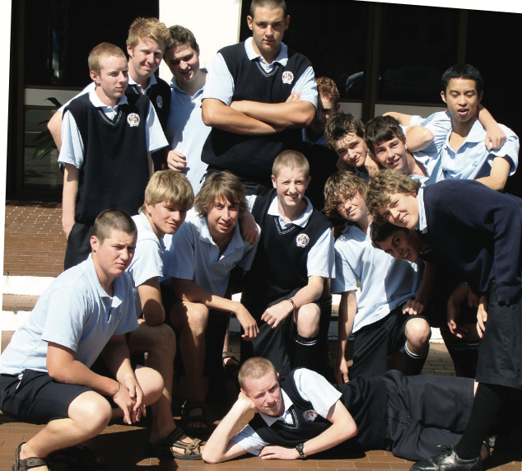
SOURCES
CATHOLIC SOCIAL TEACHINGS
PRINCIPLES
SEE
JUDGE
ACT

Slide 21


1. What is God like?
How is God revealed to us?
2. Why the doctrine of the Trinity matters
3. Who is Jesus?

Slide 22


SCRIPTURAL THEMES
The Reign of God
“We can say without hesitation that from then on Jesus devoted his time, his energy, and his whole life to what he called the reign of God. That was certainly the core of his preaching, his deepest conviction, the passion that inspired all his activity.” – Jose Pagola

Slide 23
SCRIPTURAL THEMES
The Reign of God
The Great Commandment
3 Great Parables
  The Good Samaritan
  The rich man and Lazarus
  The Last Judgement in Matthew 25
Care for the Anawim
The concept of Jubilee
PLUS
The ongoing revelation of God whereby the Risen Christ through the gift of his Spirit continues to inspire, to challenge , to teach, to guide...

Slide 24
OUR STORY
Year 1-2: Develop an understanding that every person is a gift from God, and tapu because of who we are, and that every person can have manas through right relationships to Atua, whenua and tangata.
Year 13: Reflect on the Catholic understanding that we are called to make our own unique contribution to a just society and a better world.

Slide 25

BEING CHURCH
Year 3-4: Recognise that the Church has special Sacraments of Healing: Reconciliation, Eucharist and Anointing of the Sick.
Year 12: Develop an understanding of the Christian vision of justice and explore contemporary issues of justice and peace and the Church’s response to them.

Slide 27
My Hope:
We see the connection between our lived faith and our living justly
Appreciate the rich and intelligent heritage of teaching on social justice
Desire to know more

Slide 28
“Our moral framework does not easily fit categories of right or left... Our Church members are called to measure every party and movement by how the full range of their policies touches human life and human dignity.”
“The challenge for Catholics is to be principled without being ideological, to be political without being partisan, to be civil without being soft, to be involved without being used.”
Cardinal Tom Williams
How will our Year 13s vote?

Slide 29
To consider
Where is justice already happening now in your school/college?
What makes justice at your school/college any different to the school down the road
Do you have any practical suggestions to help young people recognise the connection between their desire for justice and the Catholic faith?

